Slide 1
Infrastructure tools
For
Alert and Usher
Liu, Zhichao (Bruce)
—BJ Infrastructure Team

Slide 2
Purpose of Infrastructure
Productivity
Make sure SEs and QEs can start work right away
Let SEs and QEs focus on developing and testing
Quality
Test as much as possible
Find issues as earlier as possible
Fix issues as fast as possible

Slide 3
Develop environment creation

Slide 4
Use of new environment
Developer use
Continuous Check-in testing
Issue reproduce and investigate
Demo
New branches

Slide 5
Requirements
Include all required packages
Easy to use
Ready for different purpose
Automatically up to date
Able to recover from failures

Slide 6
Alert* VM creation tool
Create an environment with a simple command
Work with vCloud and local VM
Includes:
All required system packages
Server services: tomcat, httpd and php
MySQL database
Memcache
IServer
eclipse, eclipse for php and SoupUI
Yes Daemon and auto deploy tool

Slide 7
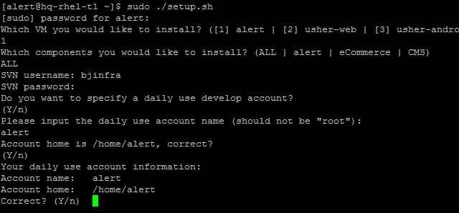
Flexible
Support multiple projects (not only alert)
All-in-one or selected components
Easy to use

Slide 8
Version control

Slide 9
Alert backend components and databases
Alert
Configuration files
CMS
DB
MD
DB
CMS
DB
Alert
DB
EC
DB
IServer
CMS
EC
Configuration files
Configuration files
Configuration files

Slide 10
Version matching requirements:
Code to code
Code to configuration files
Code to databases
Code to IServer
Code to test
All-in-one build
Same build number to code, DB, settings, tests
Pick up each components from different time

Slide 11
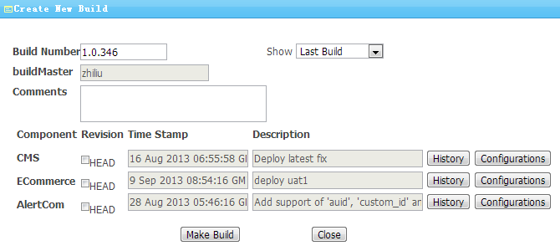
Build creation
One single build number
Comments and description (short label)
Time stamp
Check-in list
Create build based on previous builds

Slide 12
All-in-one build creation
Build #1
1st Sep
Build #9
10th Sep
Latest code
Now
CMS
Alert
EC
Build #10
Alert from Build #9
CMS from Build #1
EC compile latest code

Slide 13
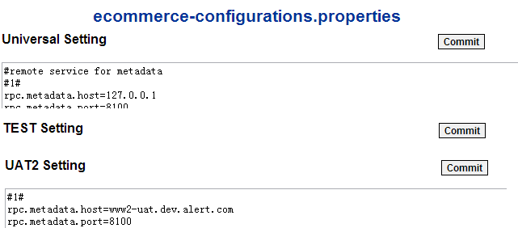
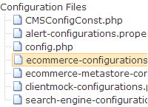
Configuration files
Multiple files and different environments
Universal settings
Environment related settings

Slide 14
Universal settings
#remote service for ecommerce
ecommerce.proxy.host=localhost
ecommerce.proxy.port=8100
ecommerce.proxy.path=webservice/remote
ecommerce.proxy.url=http://${ecommerce.proxy.hos…
#remote service for ecommerce used by alert
ecommerce.url.root=http://${ecommerce.proxy.host…
#remote service for payment (environment related)
payment.url.root=http://www2-uat.dev.alert.com:4080/
#remote service for CMS (environment related)
cms.url.root=https://www2-uat.dev.alert.com:2443/CMS2/
http.max_connection=500
Configuration file for UAT1
#remote service for ecommerce
ecommerce.proxy.host=localhost
ecommerce.proxy.port=8100
ecommerce.proxy.path=webservice/remote
ecommerce.proxy.url=http://${ecommerce.proxy.hos…
#remote service for ecommerce used by alert
ecommerce.url.root=http://${ecommerce.proxy.host…
#remote service for payment (environment related)
payment.url.root=http://www1-uat.dev.alert.com:4080/
#remote service for CMS (environment related)
cms.url.root=https://www1-uat.dev.alert.com:2443/CMS2/
http.max_connection=500
Environment related settings
#remote service for payment (UAT1)
payment.url.root=http://www1-uat.dev.alert.com:4080/
#remote service for CMS (UAT1)
cms.url.root=https://www1-uat.dev.alert.com:2443/CMS2/

Slide 15
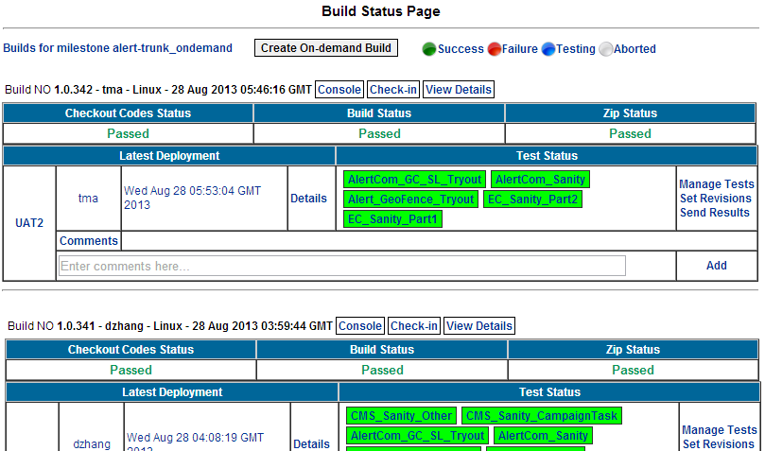
Build Status Page
View previous build and test results

Slide 16
Auto deploy
One click deploy
Multiple environment
Automatically environment clean up
Control deploy process for different environment
Control over code in different environment
Easy roll back

Slide 17
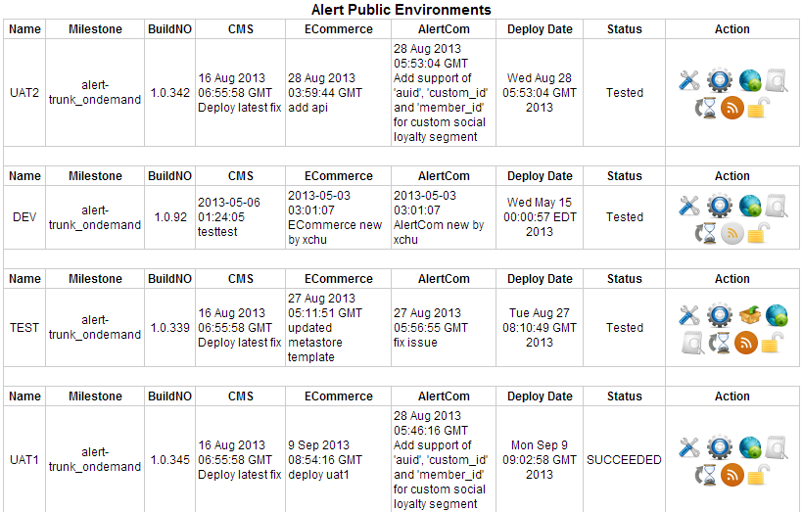
Deploy page

Slide 18
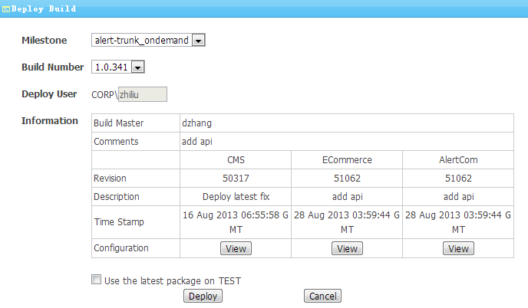
Deploy build to selected targets
Select build from list
One click deploy code, configuration files and database
Easy roll back and build-deploy
History record

Slide 19
Test trigger
Result analyze

Slide 20
Auto trigger tests
Tests triggered right after code deployed
Test version bind to code version
Analyze result
Build status report
Check-in list
Compare to last test
Show overall result
History record and trend

Slide 21
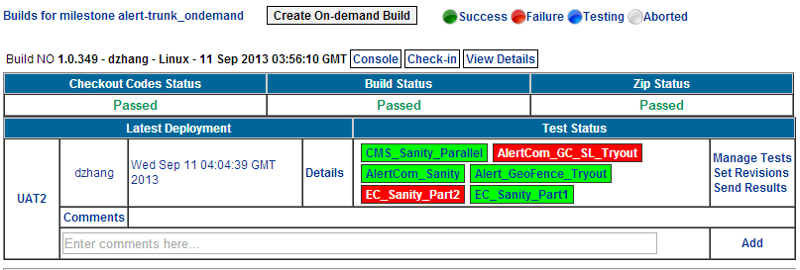
Test triggering and management
Show test results
Add comments about the test result
Send result and comments to subscribers
Set tests to run with a specified revision
Manage tests for different environments

Slide 22
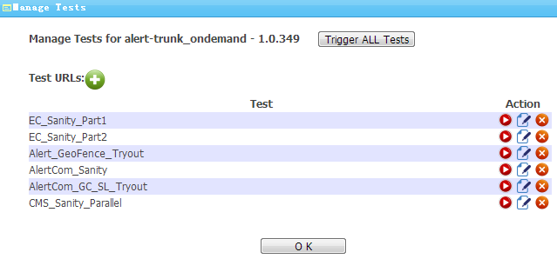
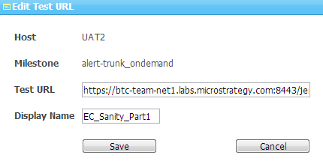
Test triggering and management

Slide 23
Continuous check-in testing

Slide 24
Unit test and sanity test for each check-in
Detect issues in early stage
Get result within 20 minutes
Fix issue
New environment for each run
Avoid environment related errors
New code
Database recreated from scratch
Latest configuration files
Sample test data
Code analyze for each check-in

Slide 25
Code check-in
Failed, inform SE
Unit test
Deploy to VM
Failed, inform SE and QE
Usually finished with 5 minutes
Stop services
Recreate databases
Prepare test data
Sanity test
Clean cache
Deploy code
Republish cube
Deploy settings
Start services
Post process

Slide 26
What’s more
Extendable to other social projects
VM creation
Auto deploy
Continuous check-in testing
Test result analyze
Environment check tool
Standalone and light weight
Can work with different environment
Database schema check
Environment settings check

Slide 27
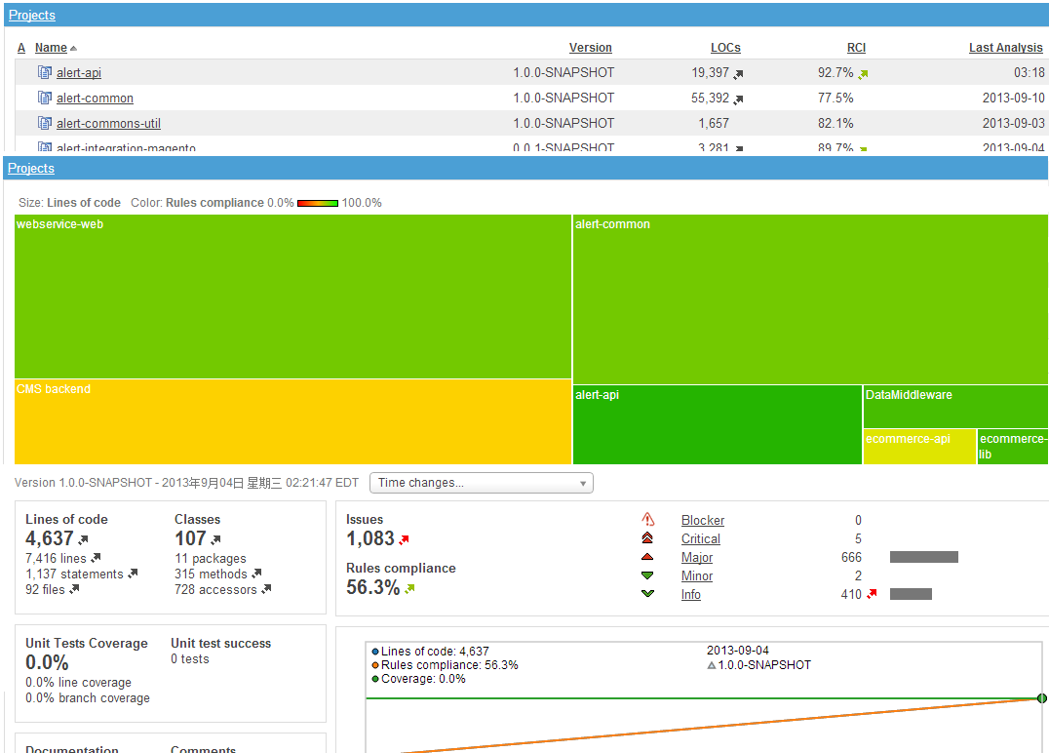
What’s more
Code analyze with Sonar

Slide 28
Future plans
Cover more projects
Code coverage
Feature coverage
Generate test suite with code/feature coverage
Monitor server status
Integrate with TQMS
Integrate with platform tools

Slide 29
Q&A
Thanks!

Slide 30
Tool list
Alert* VM creation tool
Create an environment with a simple command
The Build Status Page (BSP)
Make build of all components and give them a single build number
Trigger build deploy and send deploy notifications
Trigger test, collect and analyze result, show test status
Handle configure files for different environment
Auto deploy tool
Deploy code, configure, database to target environment
Deploy other preparations
Check deploy status and environment settings
Continuous integration
Auto test on every code check-in and catch bugs

Slide 31
Auto deploy tool
Light weight and easy to use
Deploy code
Clean up before deploy
Skip if no code changes
Deploy configuration files
Environment specified configuration files
Latest or version controlled configuration files
Deploy database
Schema creation
Schema clone
Data clone
Database clone

Slide 32
Auto deploy tool
Other operations
Stop and start tomcat
Clear memcache
Restart Iserver
Run commands
etc.
Check correctness for setting and database
Logs and error handling
Info logs
Error report
Deploy status report and history log
Control file

Slide 33
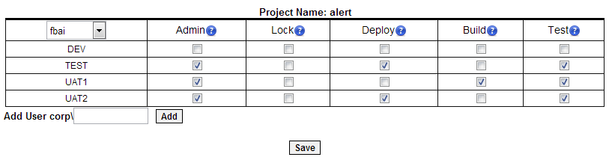
Build Status Page
Security control
Corp account login
Project
Environment
Privileges: Lock, Deploy, Build and Test
Environment owner

